Slide 1
DDD Mode Pacemaker
COMPSYS 303 Assignment 2
Savi Mohan, Mark Yep (Group 3)

Slide 2
Introduction
DDD Mode Pacemaker
Senses from both atrium and ventricle
Paces both atrium and ventricle
Support both Triggered and Inhibited pacing
SCCharts
Synchronous state chart software
Simplifies development of complex concurrent systems
Nios II Processor
Platform for embedded systems
The Processor is programmed onto FPGA device

Slide 3
SCCharts Design
Timers
Operation achieved using 6 timers, perform certain actions when they expire.
Each timer represented by two regions in SCCharts
Concurrently running
Interact to correctly pace the heart
Logic
Additional state charts synchronise timers to get DDD timing diagram
Also handle inputs and outputs
Internal signals link the timers to the logic state charts

Slide 4
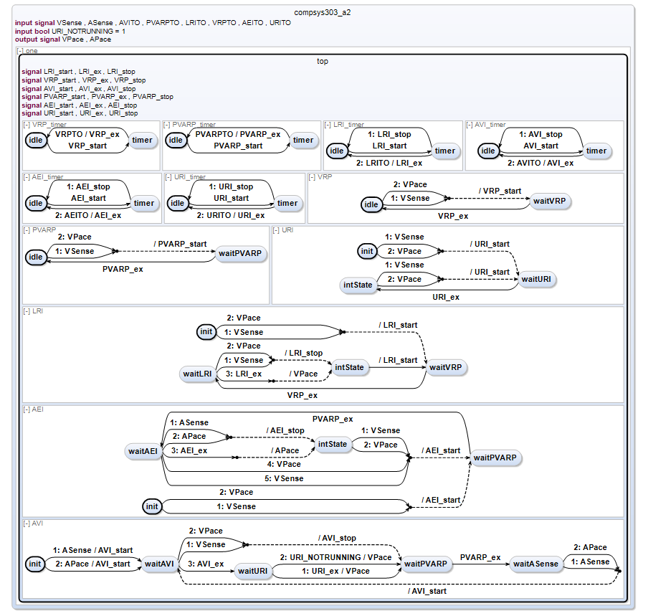

Slide 5
SCCharts Features
Concurrent state charts are developed through writing statements
States, transitions, connector states
Graphical diagrams are generated automatically
Can then compile into C code

Slide 6
Altera Nios II Project
Timers
Implemented with alt alarms
Timers for pacemaker intervals
Timers for pacemaker signals length
Debounce timers for LEDs and buttons
Inputs
Buttons
UART signals from virtual heart emulation
Outputs
LEDs

Slide 7
Linking SCCharts and Nios II
SCCharts compiles to C code
C code and header file included in Nios II project
Inputs to SCCharts
Vsense and Asense
Timeout flags for timers
Outputs from SCCharts
Vpace and Apace

